Slide 1
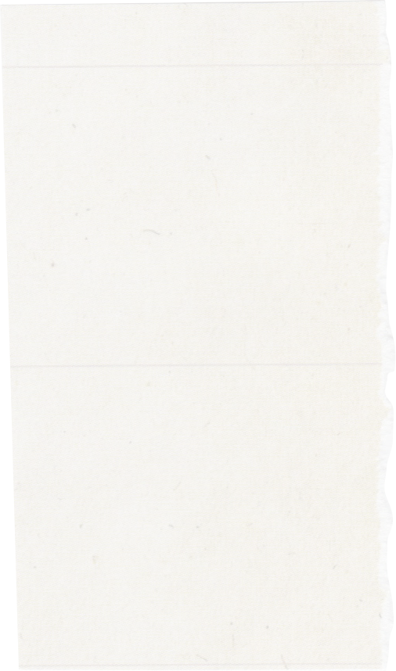
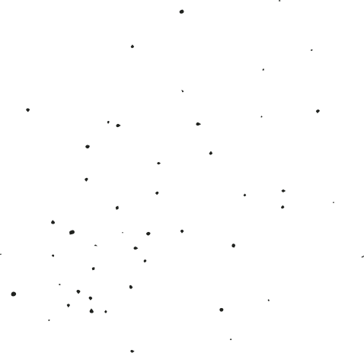

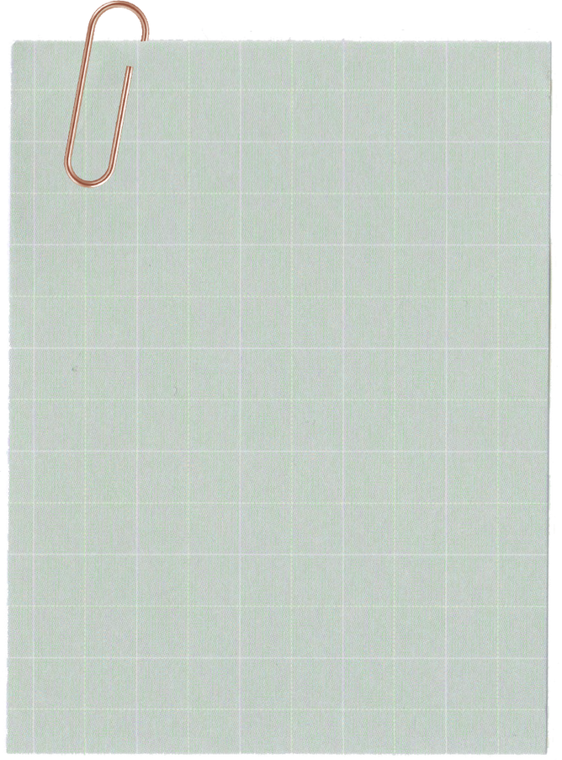
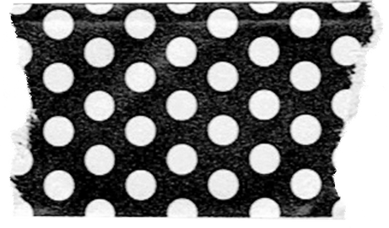
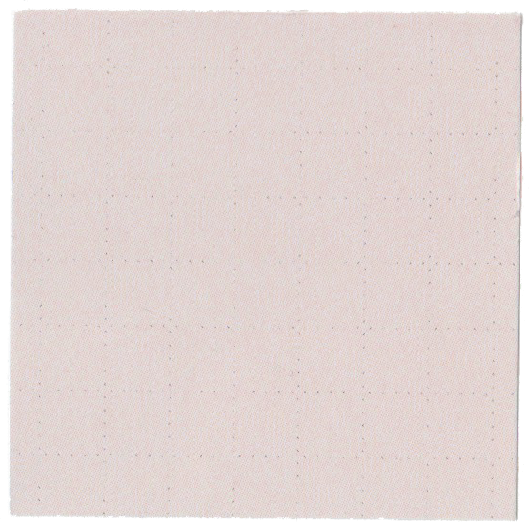
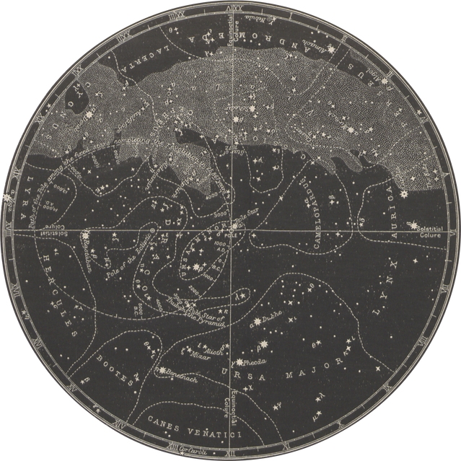
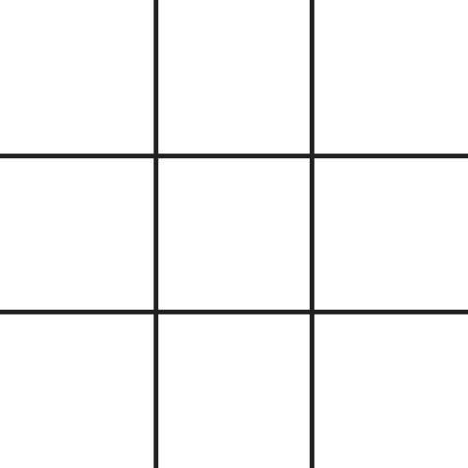


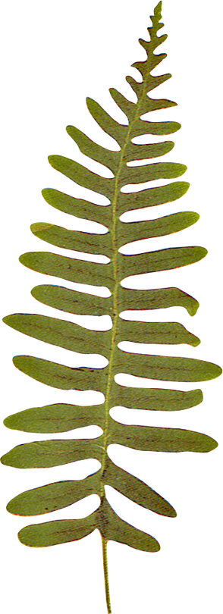
LET'S PLAY
TIC
TAC
TOE

Slide 2
Alpha - Beta Pruning
Alpha-Beta Pruning is a technique that eliminates improbable paths to reduce computational effort when searching game trees.
This results in more efficient decision-making.
Tic Tac Toe Game
Tic Tac Toe is a classic two-player game where opponents take turns marking a 3x3 grid.
The objective is to form a row of three symbols (X or O) horizontally, vertically, or diagonally.

Slide 3
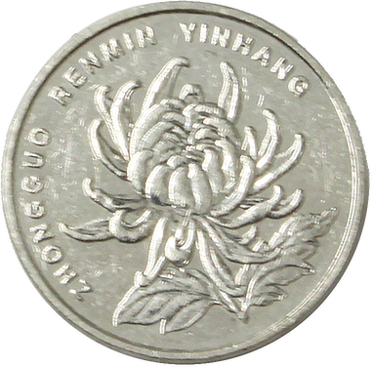
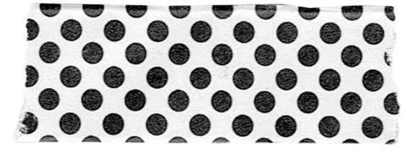
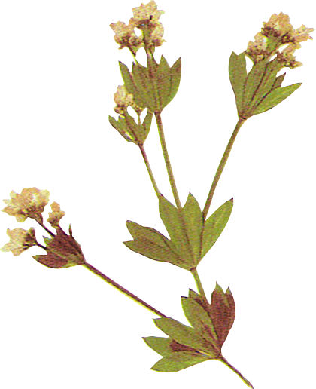
Player 1
Player 2
Objective
The goal is to form a row of three of your symbols (X or O).
Rows can be horizontal, vertical, or diagonal.

Slide 4
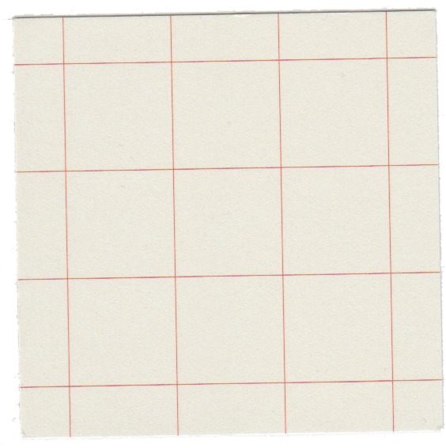
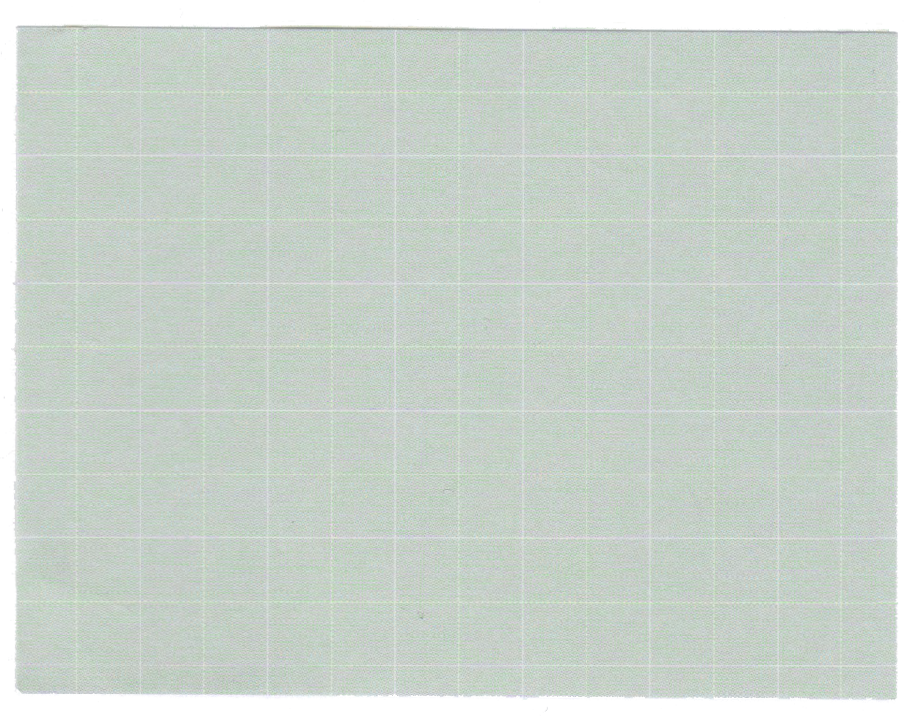
Minimax Algorithm for Tic-Tac-Toe
Maximizing Moves: The AI player (maximizer) strives to make the best possible move, leading to a winning or favorable outcome.
Minimizing Countermoves: The human player (minimizer) aims to counteract the AI's moves, minimizing the AI's advantage.
Recursive Evaluation: The Minimax algorithm recursively evaluates each possible move and assigns a score based on its outcome, considering all potential countermoves.

Slide 5
Enhancing Minimax with Alpha-Beta Pruning
Computational Efficiency: Alpha-beta pruning is an optimization technique that prunes unnecessary branches of the game tree, reducing computation time.
Alpha: It is the best choice so far for the player MAX. We want to get the highest possible value here.
Beta: It is the best choice so far for MIN, and it has to be the lowest possible value.

Slide 6
Pruning Strategy: If a node's score is less than or equal to alpha or greater than or equal to beta, the entire subtree under that node is pruned.
Optimal Move Selection: By pruning unnecessary branches, Alpha-beta pruning significantly reduces the number of nodes evaluated, enabling efficient move selection.

Slide 7
Work Flow
Consider the following Tic-Tac-Toe board:
The current player is O, and they are considering the following moves:
Place an O in the top right corner.
Place an O in the center square.
Place an O in the bottom right corner.

Slide 8
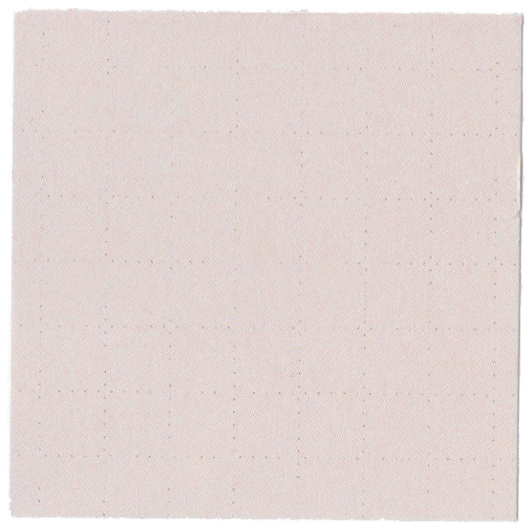
Here is how the alpha beta pruning algorithm works:
Evaluate the first move (place an O in the top right corner). This move results in a board with two Os and two Xs, so the score for this move is 2 - 2 = 0.
Evaluate the second move (place an O in the center square). This move results in a winning board for O, so the score for this move is 1.
Evaluate the third move (place an O in the bottom right corner). Since we have already found a winning move, we can prune the rest of the tree.
Therefore, the best move is to place an X in the center square.

